Slide 1


"Symptom Tracker and Information Hub" rashmitha eri

Slide 2



Contents:
AIM
MODULES USED
KEY BENEFITS
CODE
OUTPUT

Slide 3

Aim:
The aim is to provide users with a reliable and easy-to-use tool, the "Symptom Tracker and Information Hub," to input their symptoms and receive accurate information about potential health conditions.
This tool aims to offer peace of mind and guidance to users when navigating their health concerns, amidst the abundance of online medical information that can be confusing and unreliable.

Slide 4

Modules used:
Pandas: Utilized for data manipulation and analysis.
Regular Expressions (re module): Employed for text processing and pattern matching.
Tkinter: Utilized for creating the graphical user interface (GUI).
Matplotlib: Utilized for generating visualizations such as bar plots, aiding in the representation of data.

Slide 5

KEY BENEFITS:
The project empowers users to take control of their health by providing them with tools to track and understand their symptoms effectively
Users can quickly input their symptoms and receive relevant information, saving time compared to traditional methods of researching symptoms.
Regular use of the symptom tracker promotes health awareness and encourages proactive healthcare practices among users.

Slide 6
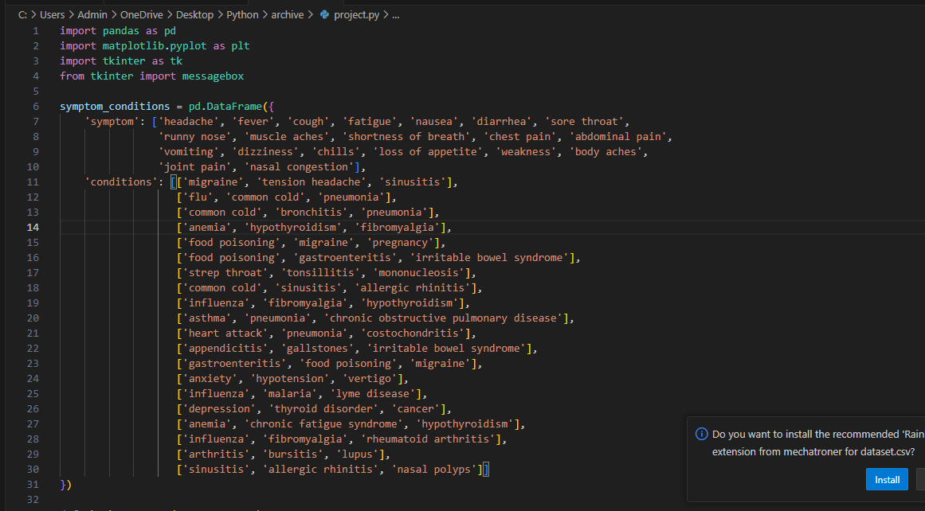

Slide 7
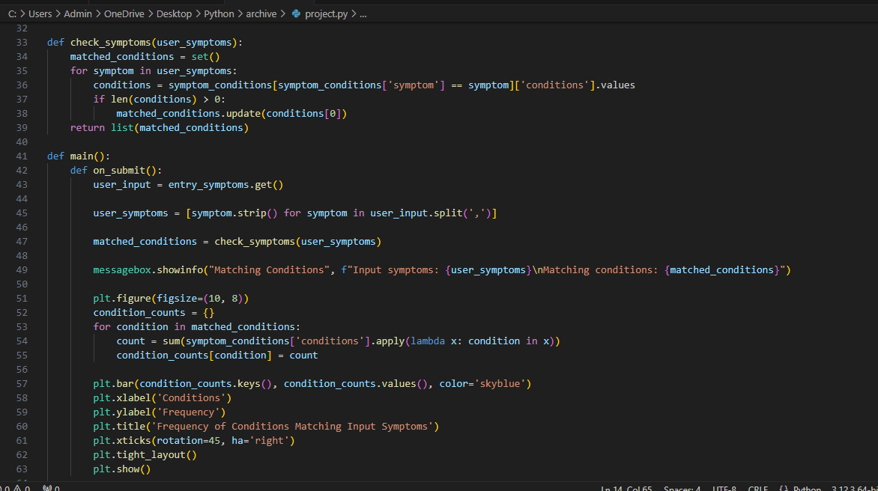

Slide 8
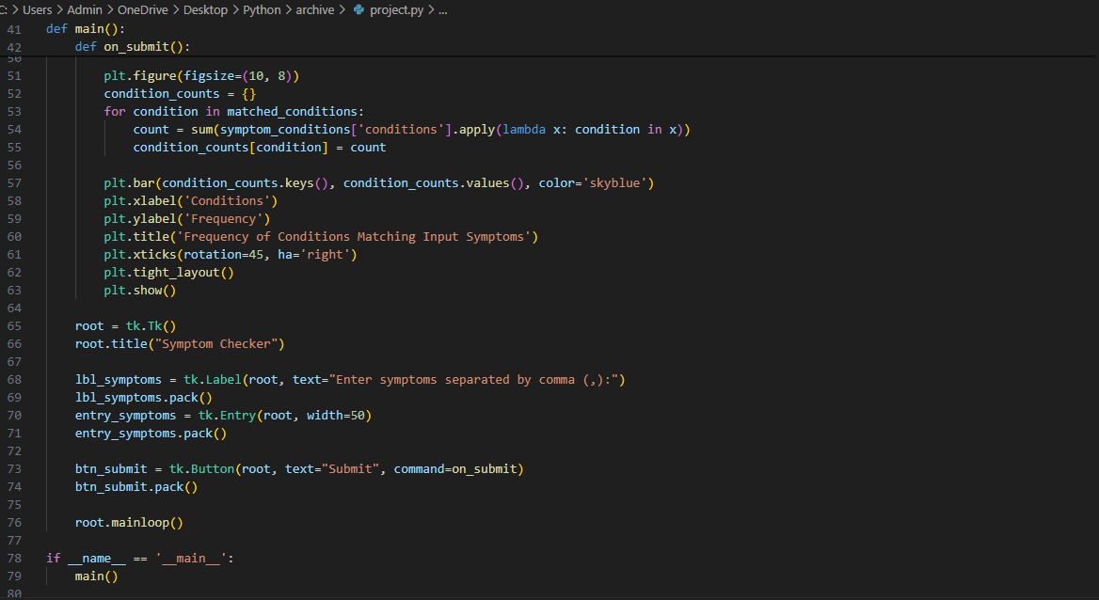

Slide 9
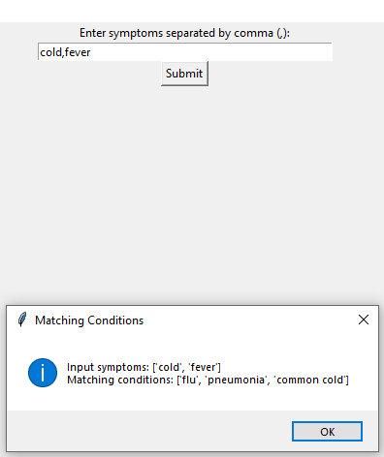
Output:

Slide 10
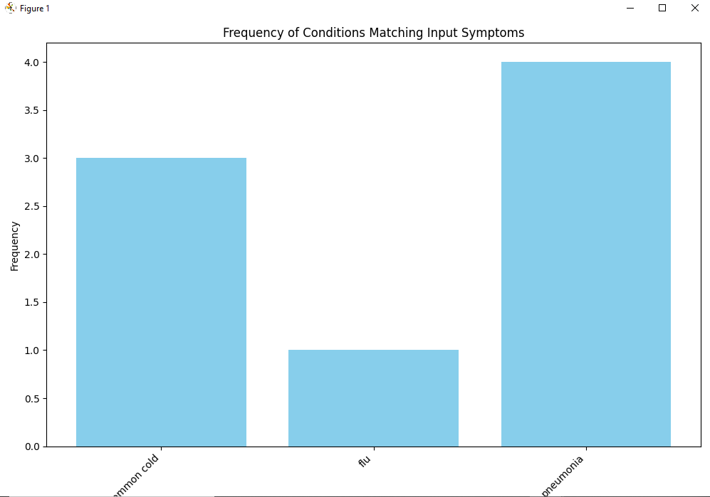
Output:

Slide 11

REFERENCES:
https://www.makeuseof.com/best-symptom-tracker-apps-medical-health/
https://inkpx.com/symptom-tracker

Slide 12


Thank you!

